Slide 1
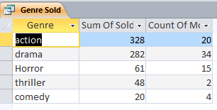
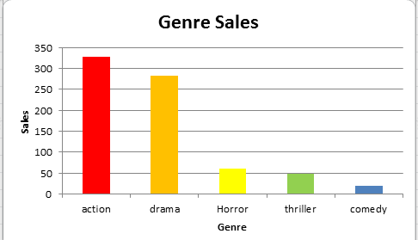
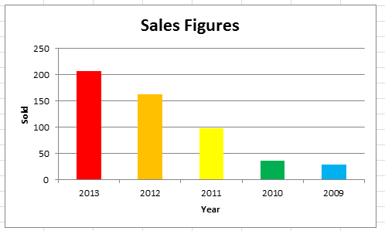
Create a new Query with the following Criteria: Make a query showing the following Fields: Genre and Sold Sum up the total sales for each Movie using the Summery Query Option and then select the count records check box. Only find the records with > 10 Movies Sold Sort the Sold Field into Descending order Export the query into an spreadsheet software. Make sure you save the query before you export
Create a graph using a suitable spreadsheet software: Select the first two columns and create a simple bar chart. Delete the legend Title: Genre Sales Horizontal Axis Title: Genre, Vertical Axis Title: Sales Format each bar so it is a different colour Extension: Repeat the same steps again however this time replace Genre with Year Only show years from 2009 – 2013. Sort the Sold Field into Descending order Only select data from the second column for the bar chart Use the select data tool to include the Years in the Horizontal Axis Title: Sales Figures, Horizontal Axis Title: Year, Vertical Axis Title: Sales Make a Report for both of the Summery Queries – Portrait and include a Count Formula.

